Slide 1
React JS – Step 8

Slide 2
React JS
React JS is an open source web library which help to develop the SPA application.
React JS is a part of Facebook company.
React JS use html, css and JavaScript.
React JS is component base architecture library
In React JS we can create the component using class, literal as well as class style.
To create the React JS project we need to use ndoe js third party library ie react

Slide 3
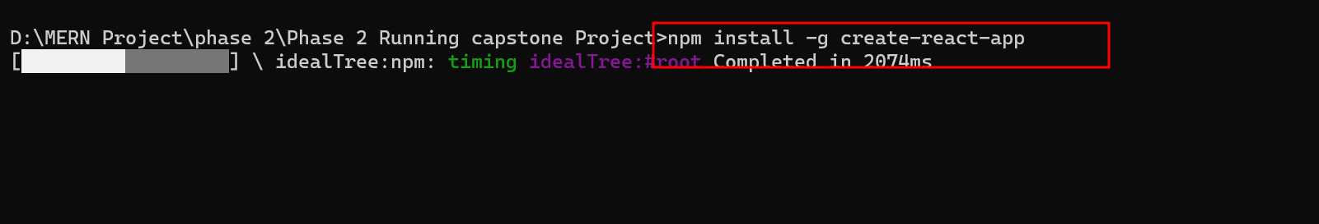

Slide 4
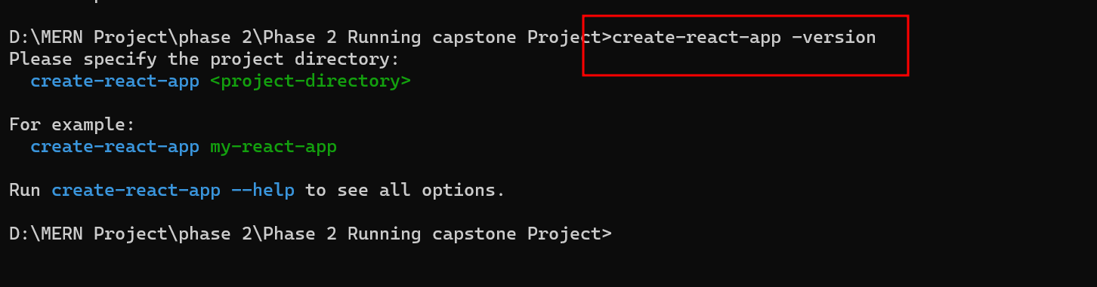

Slide 5
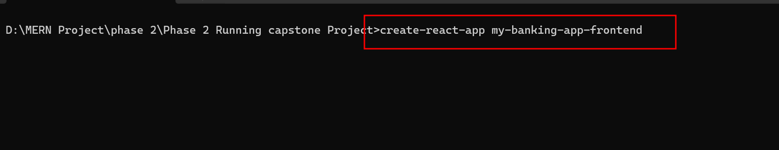

Slide 6
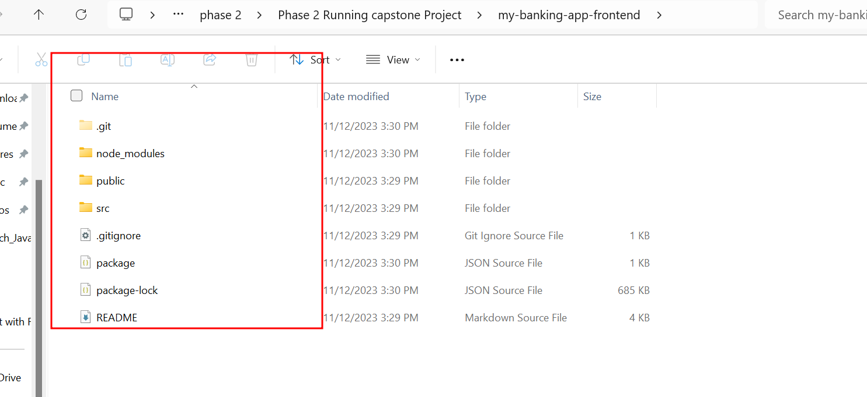
React JS project Structure

Slide 7
To run the react js project
We need to run the commands as
npm install json-server -g
npm start
It will run on default port number 3000. But if port number free then it will open 3000. else it will open another port number to run the application.
Before running this application please run json-server bankdb.json

Slide 8
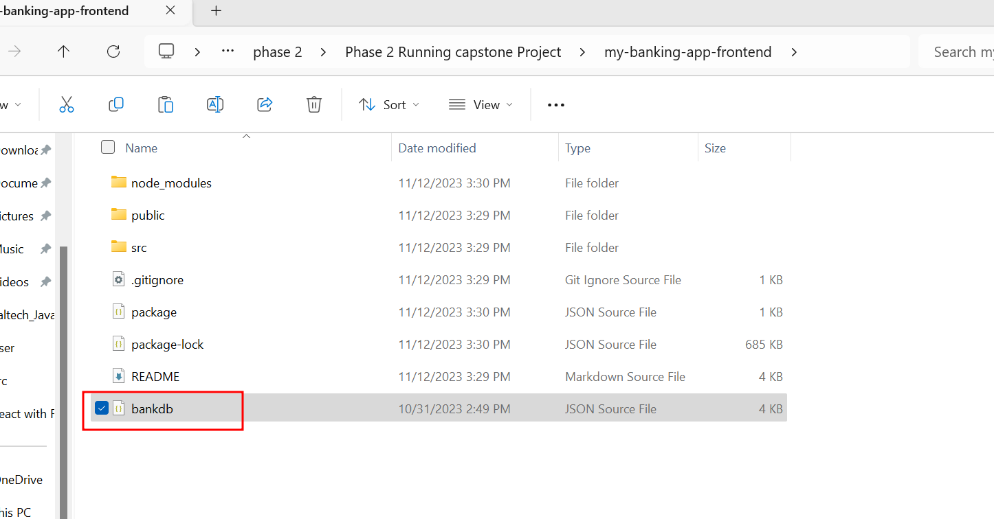

Slide 9
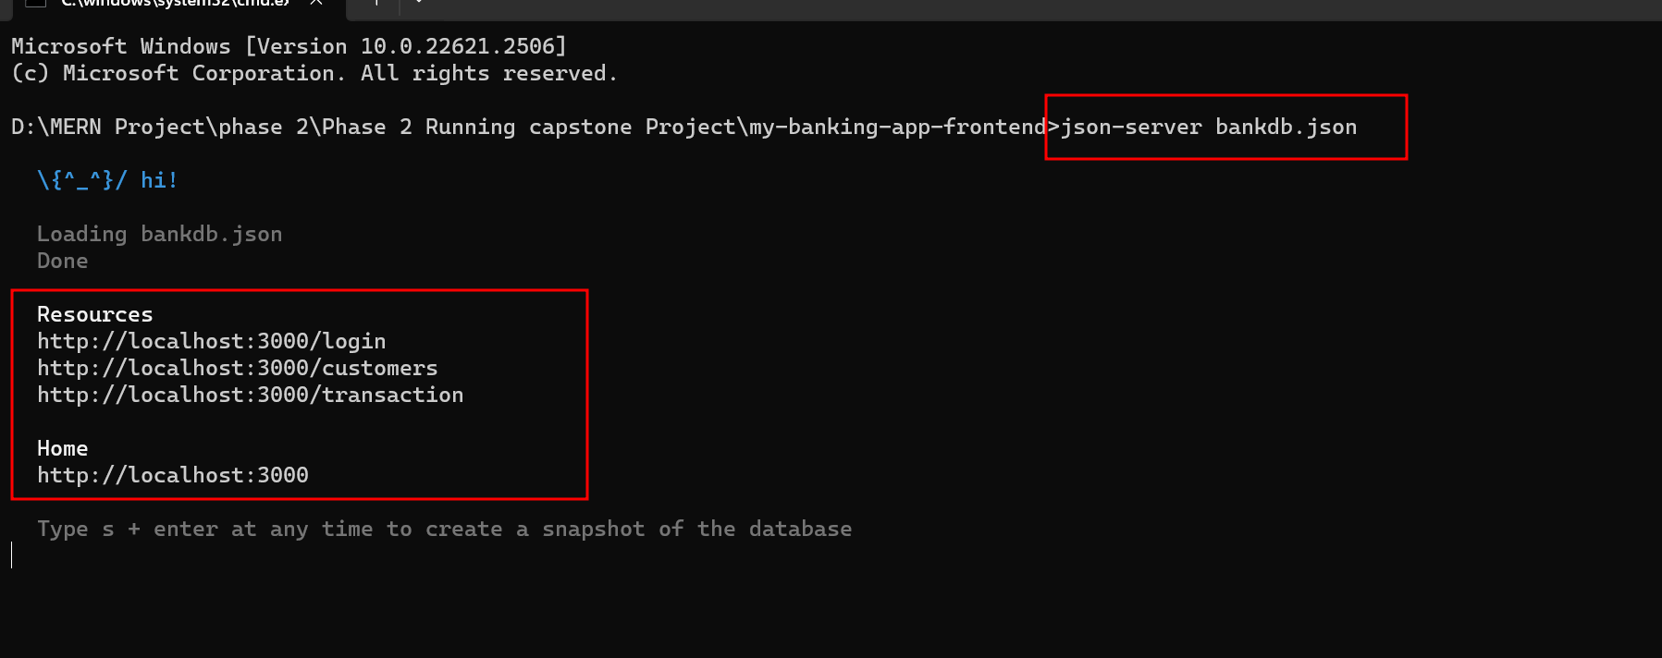

Slide 10
Open the project
Please run npm install inside a my-banking-app-frontend

Slide 11
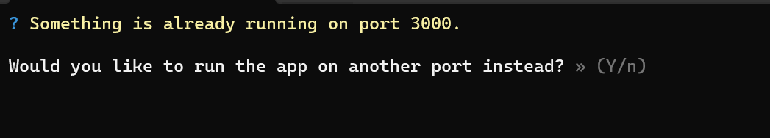
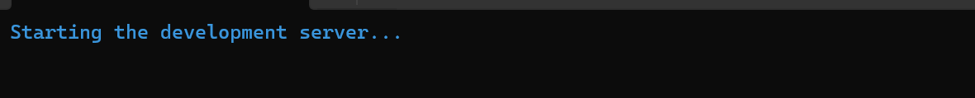

Slide 12
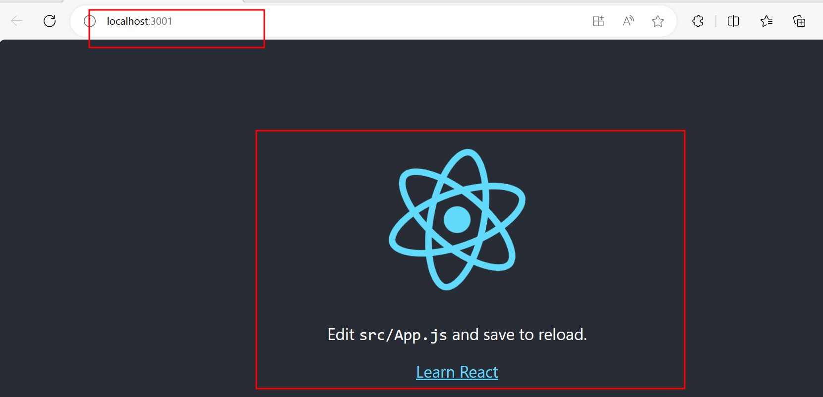

Slide 13
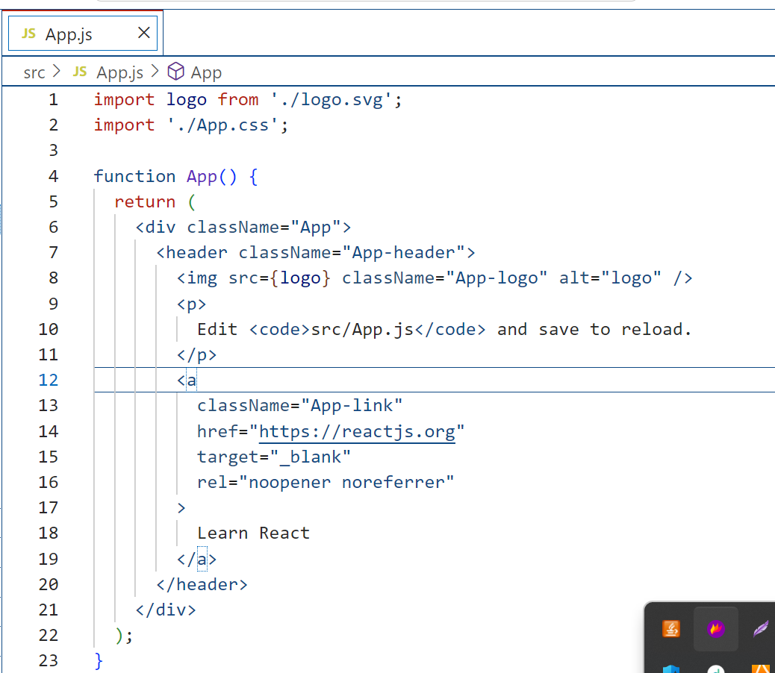
Open the project in VS code
First page of the application is App.js

Slide 14
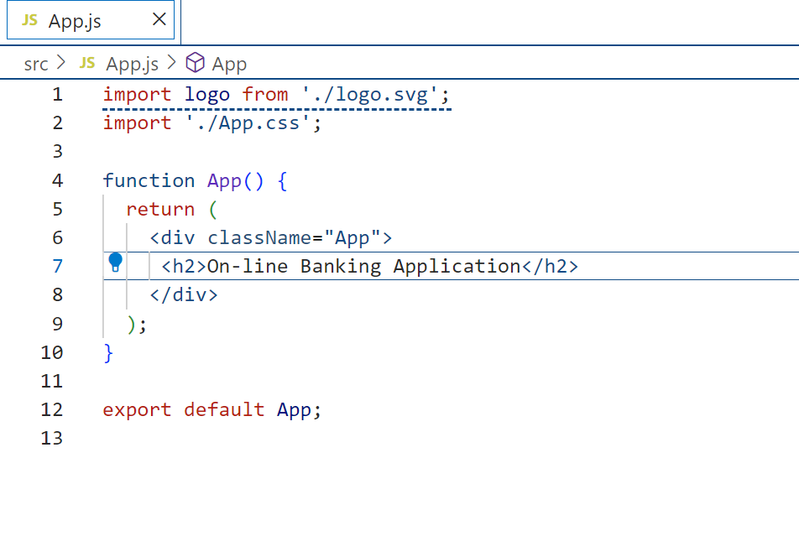
After edit in App.js file

Slide 15
Now create components
Convert all html pages like index.html, home.html, customerHome.html and adminHome.html page to React component using command as
IndexPage.js
HomePage.js
AdminHome.js
CustomerHome.js
ErrorModal.js

Slide 16
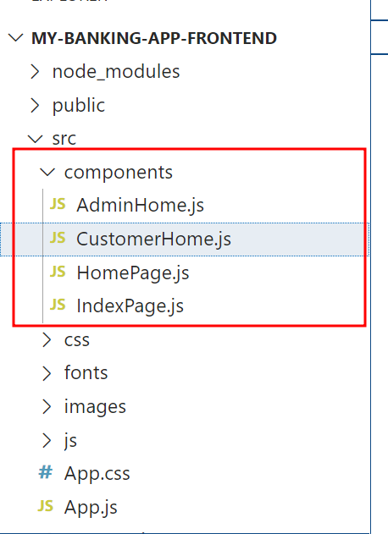
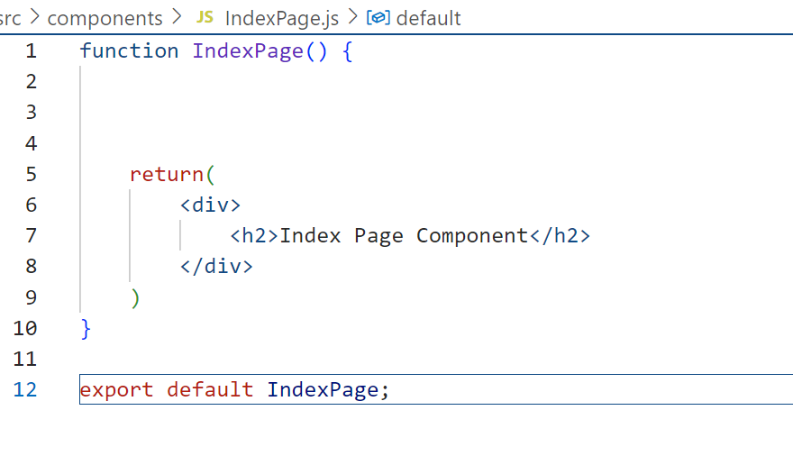
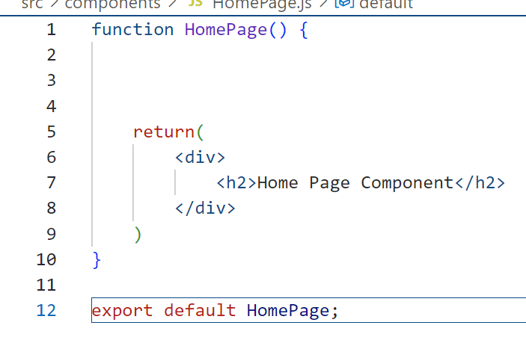
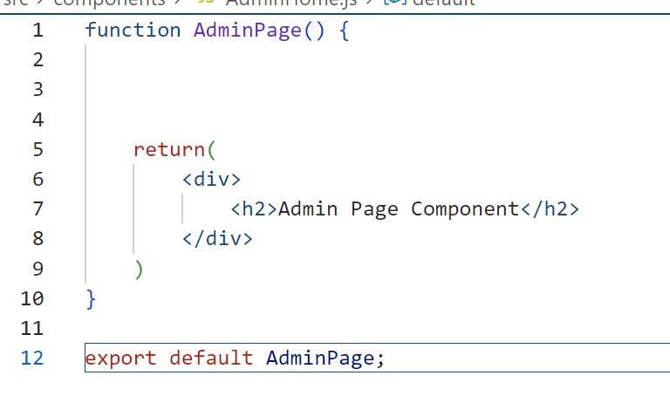
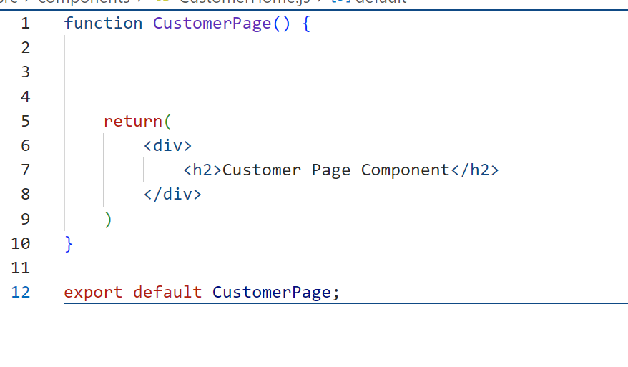

Slide 17
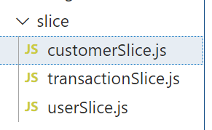
Create the slice folder with set of files
Which contains axios and redux toolkit files
customerSlice.js
transactionSlice.js
userSclie.js

Slide 18
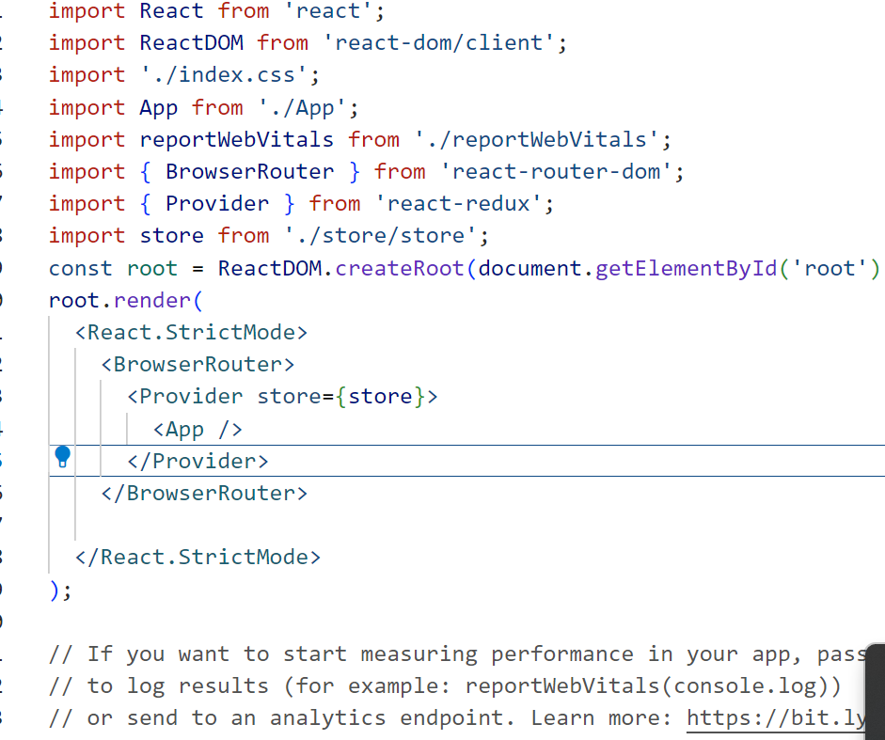
index.js file provide store details

Slide 19
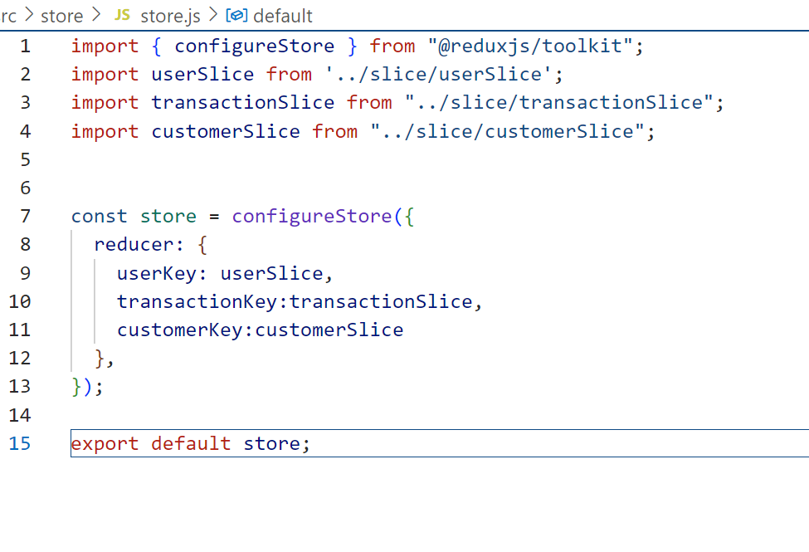
Create store file

Slide 20
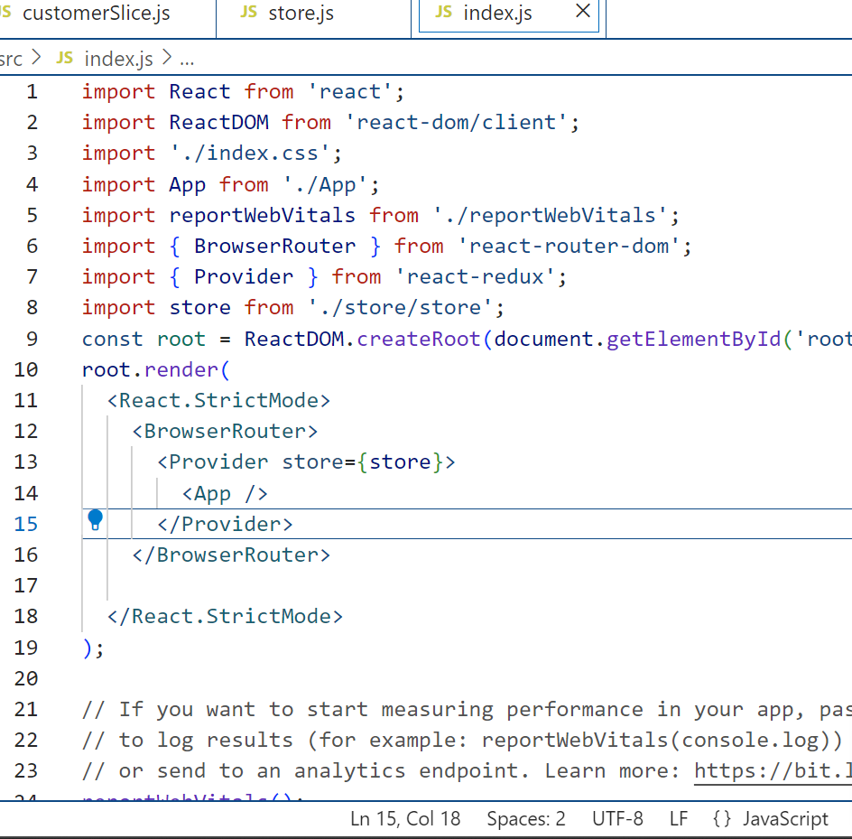
Index.js

Slide 21
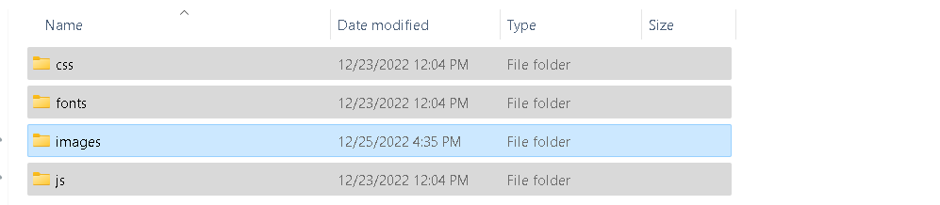
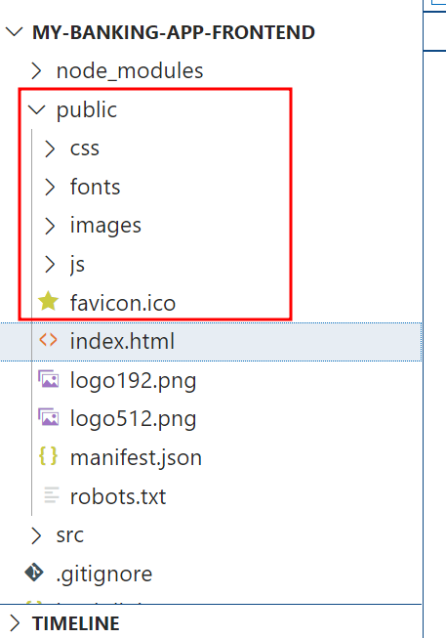
All third party plugin and resources copy and paste public folder.

Slide 22
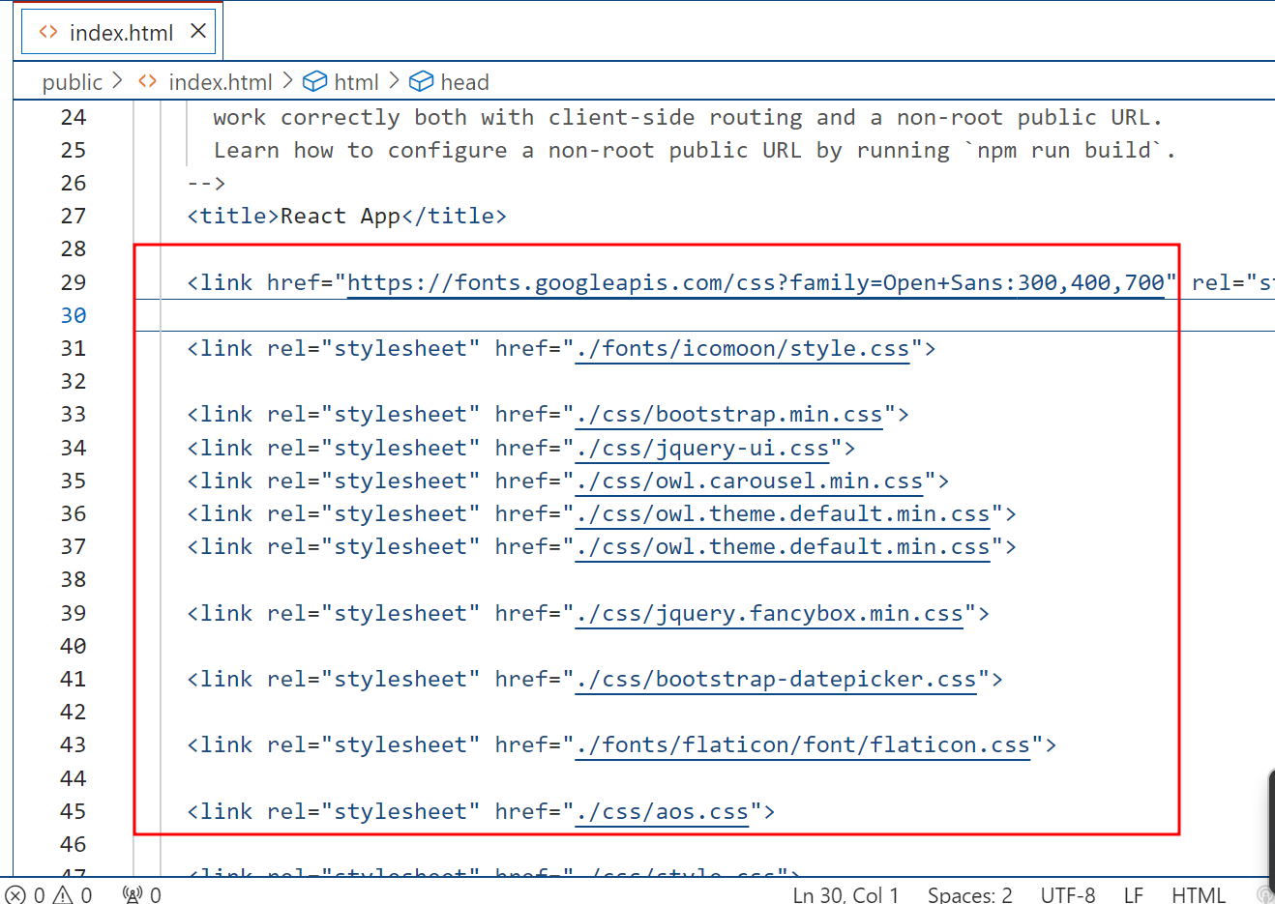
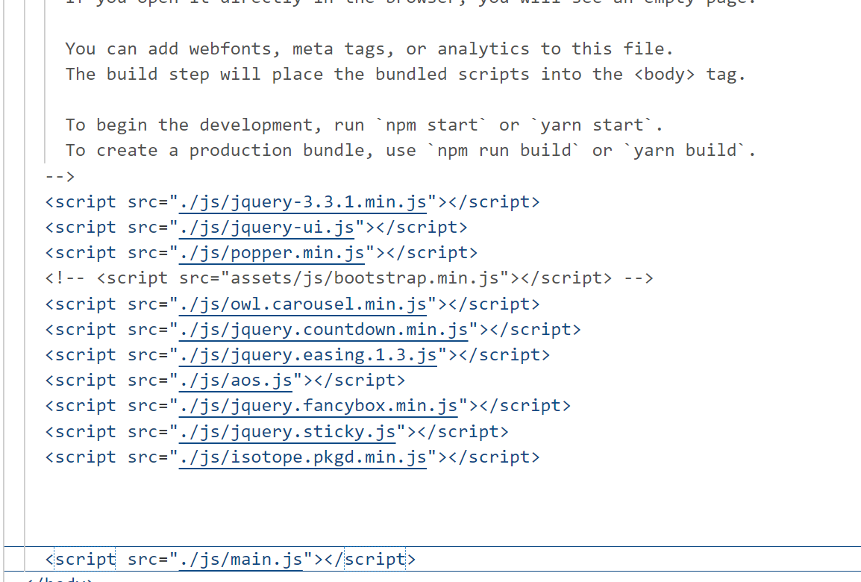
Now open index.html page and link to all third party libraries.

Slide 23
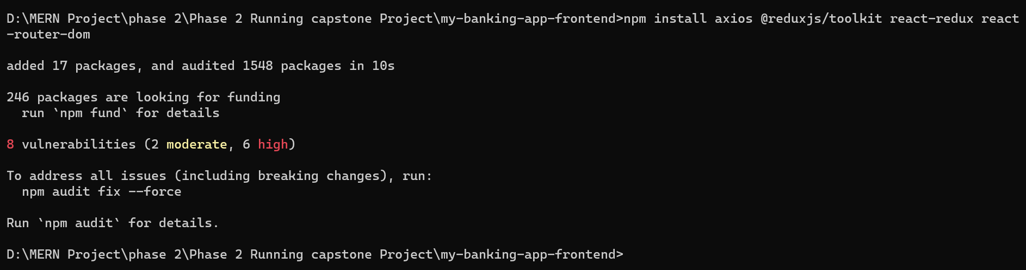
Now install third party external react js modules
npm install axios @reduxjs/toolkit react-redux react-router-dom

Slide 24
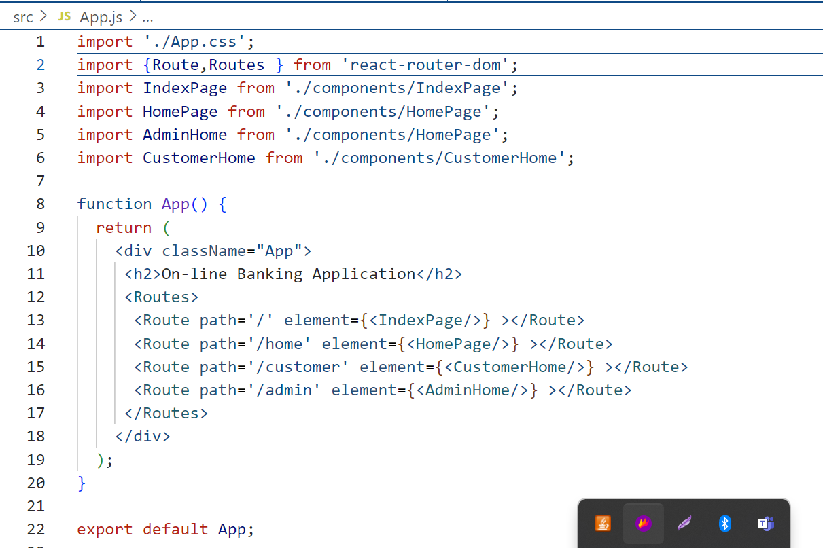
App.js file provide all routing details for the components.

Slide 25
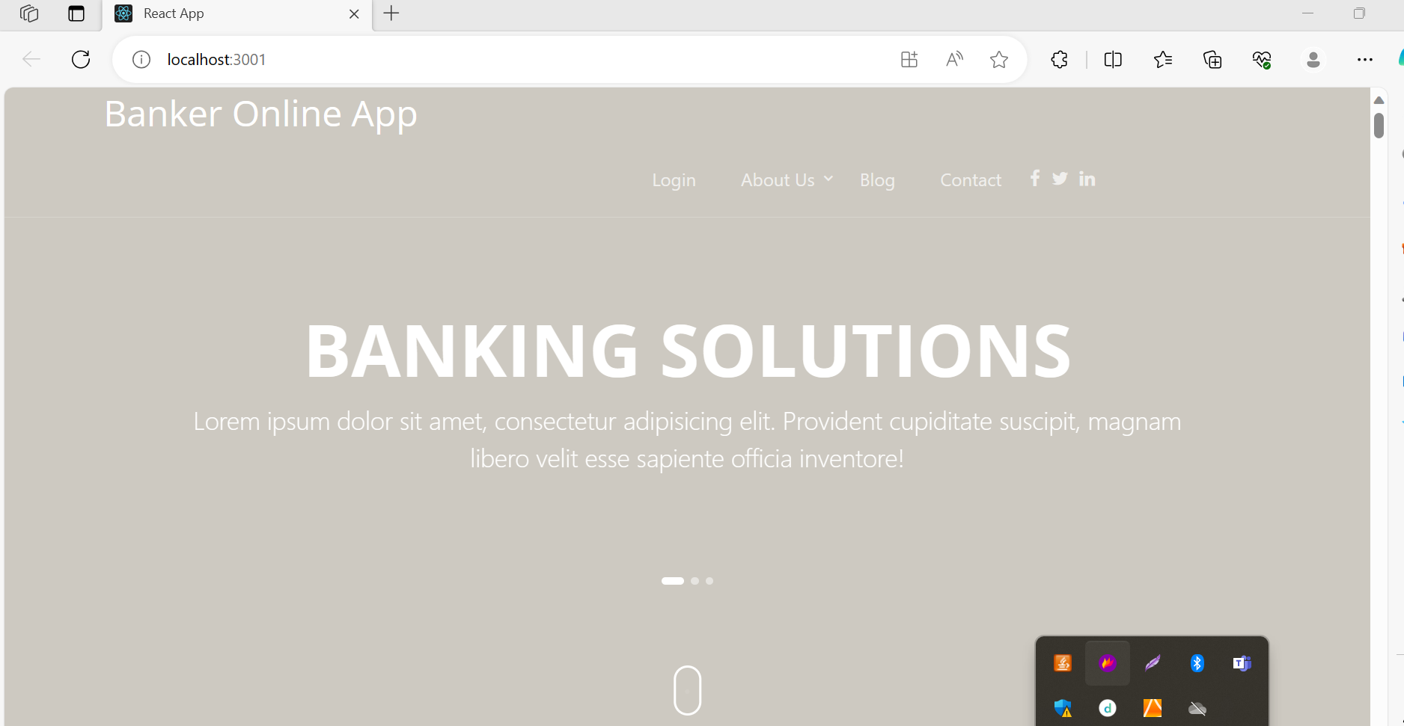
After setting all file you can see the application running.

Slide 26
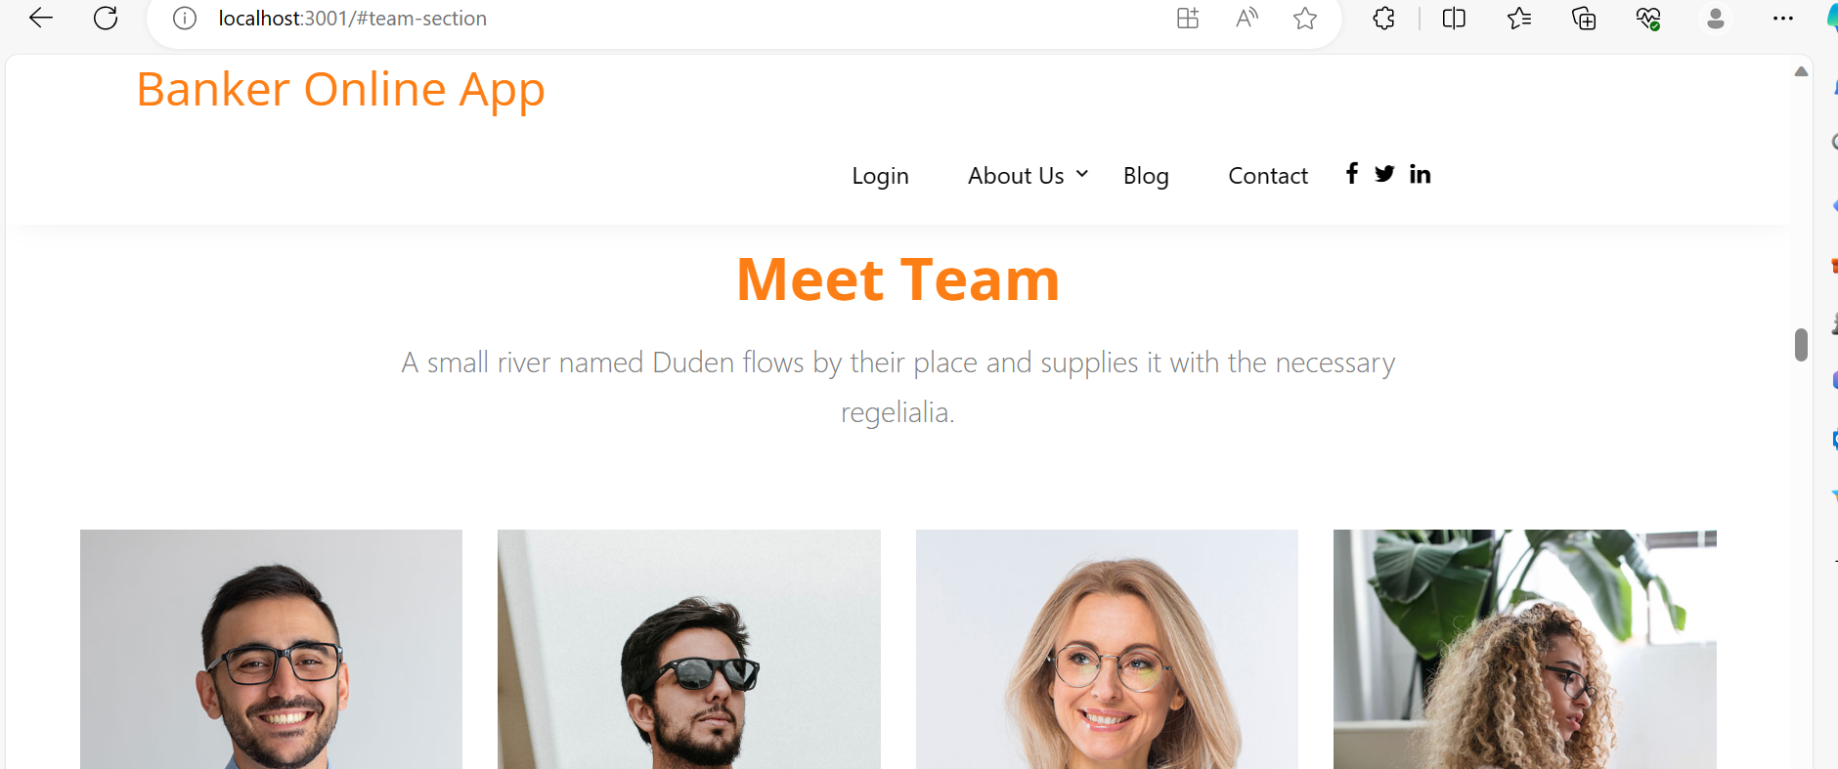

Slide 27
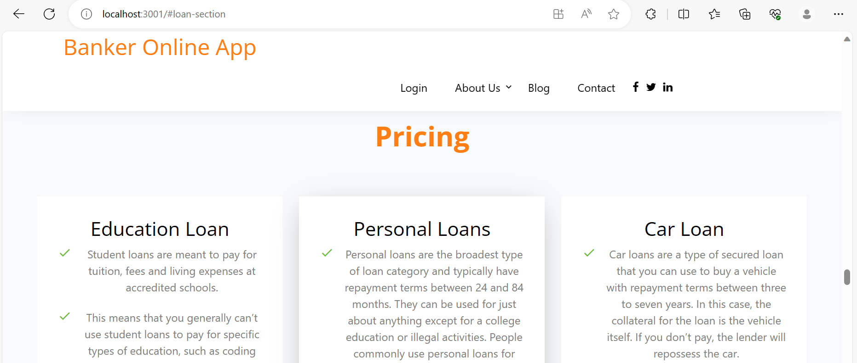

Slide 28
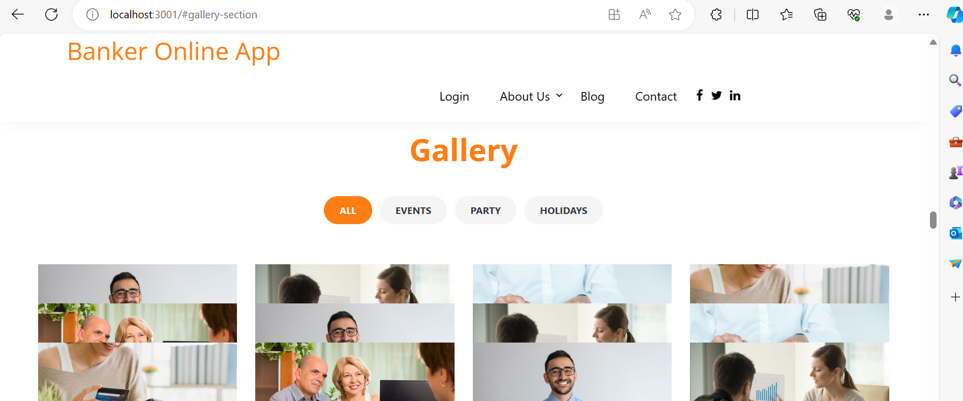

Slide 29
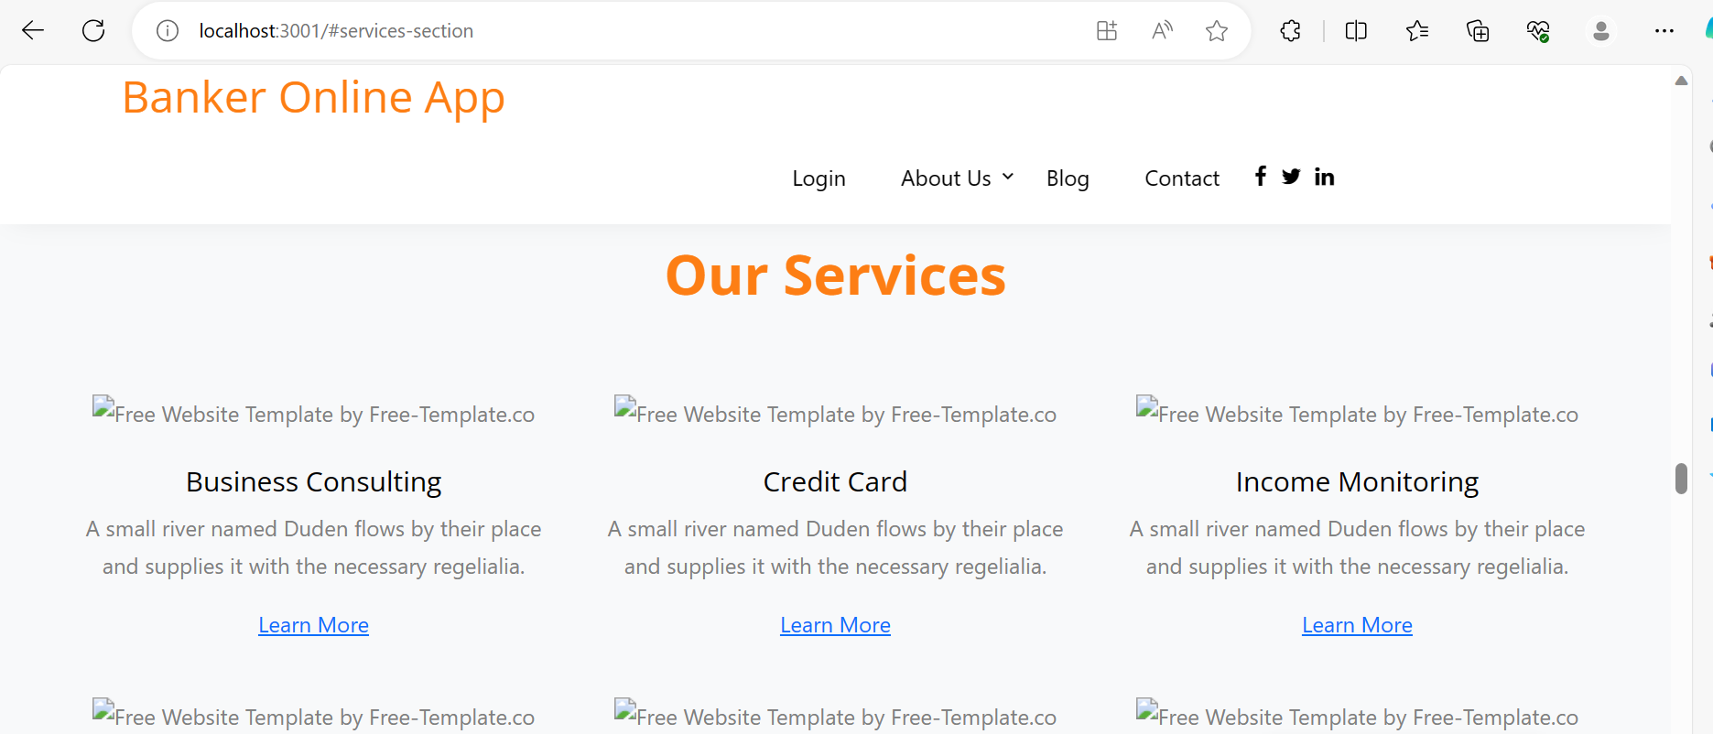

Slide 30
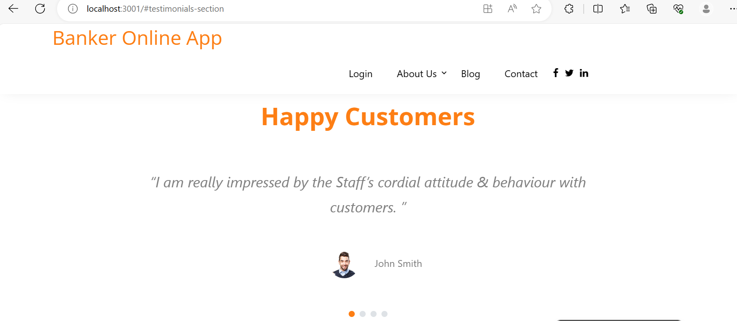

Slide 31
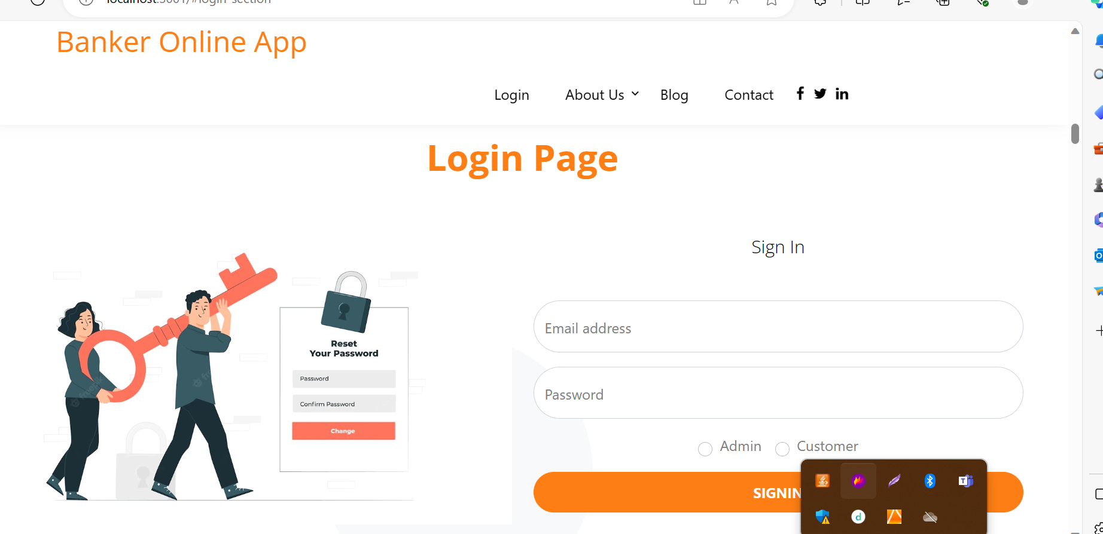

Slide 32
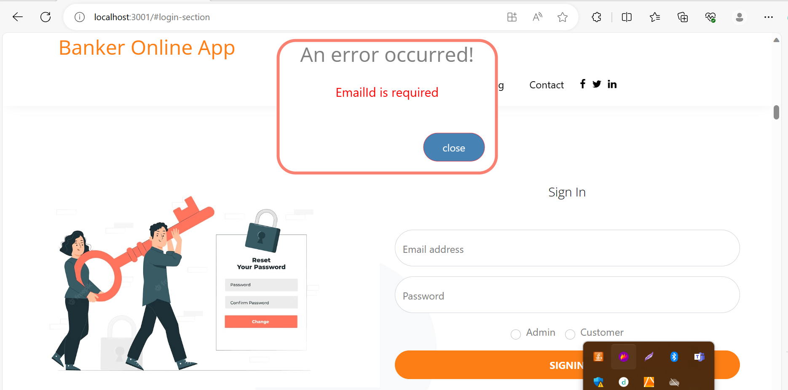

Slide 33
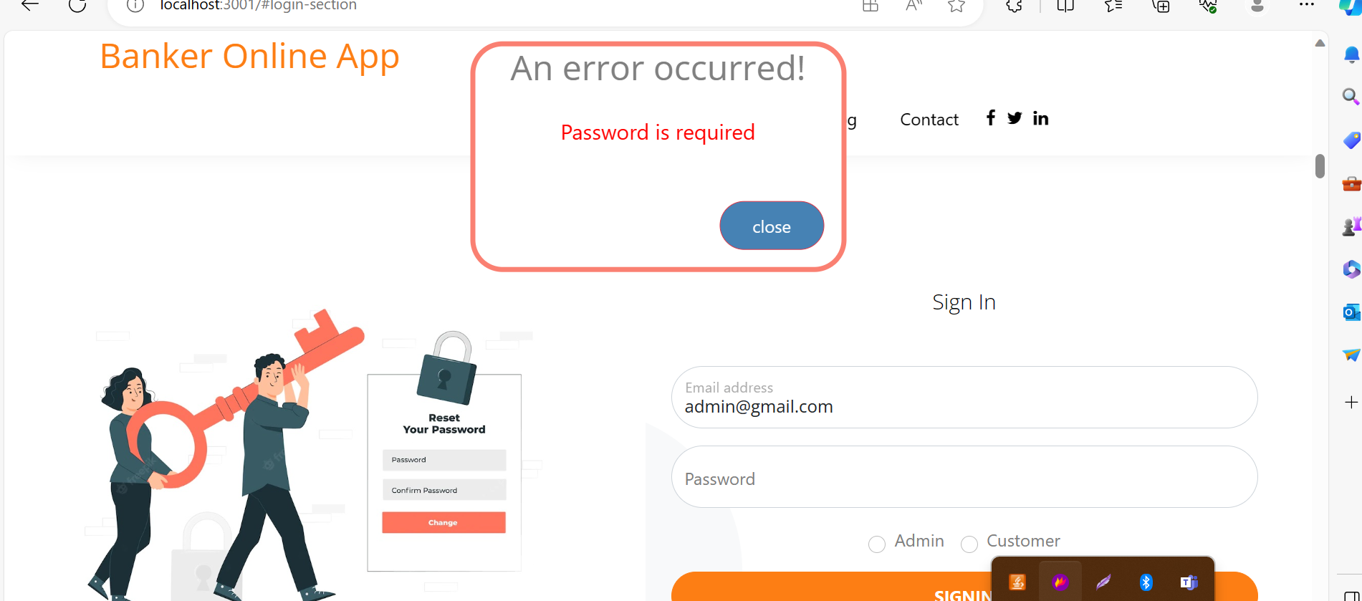

Slide 34
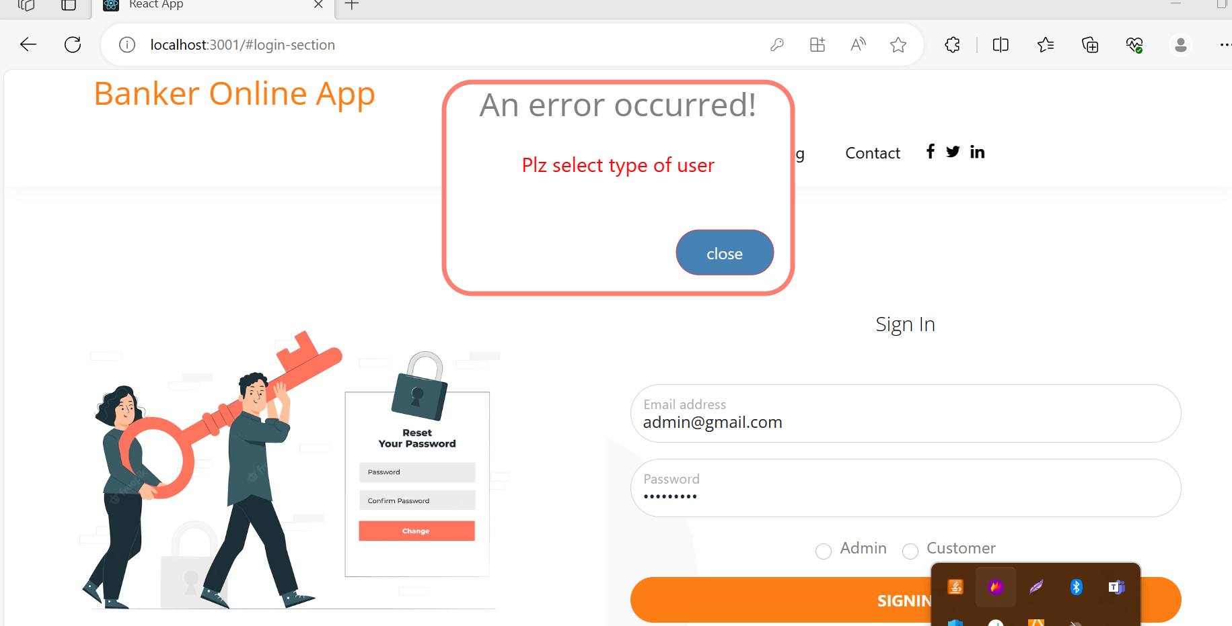

Slide 35
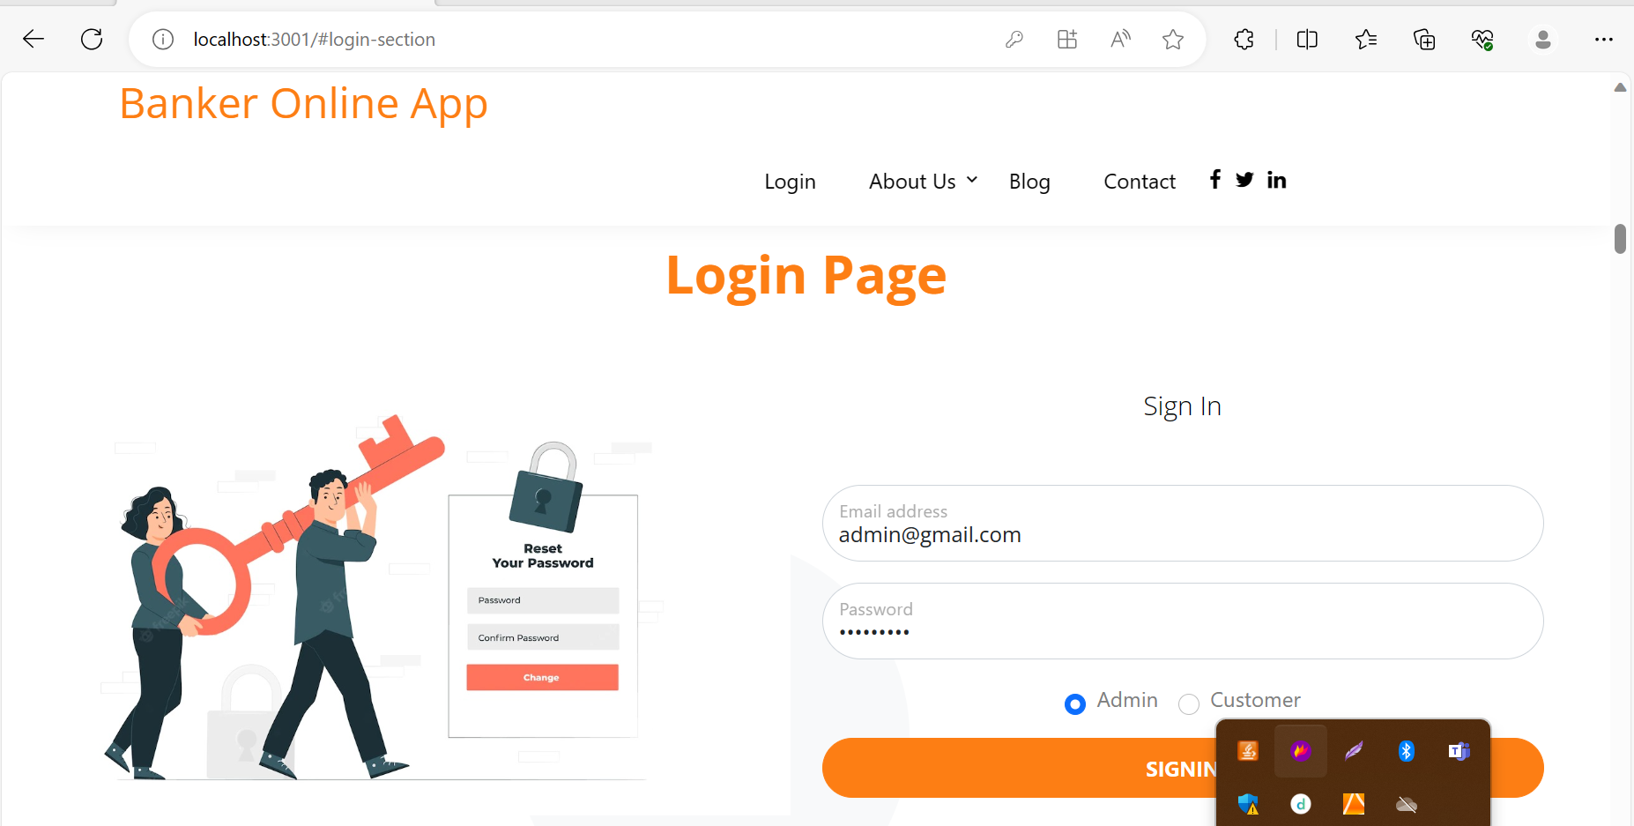
Admin login with emailed as admin@gmail.comand password as admin@123

Slide 36
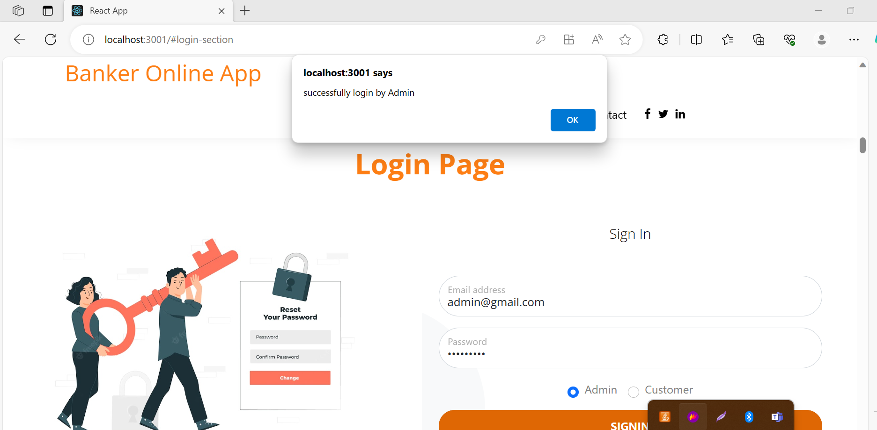

Slide 37
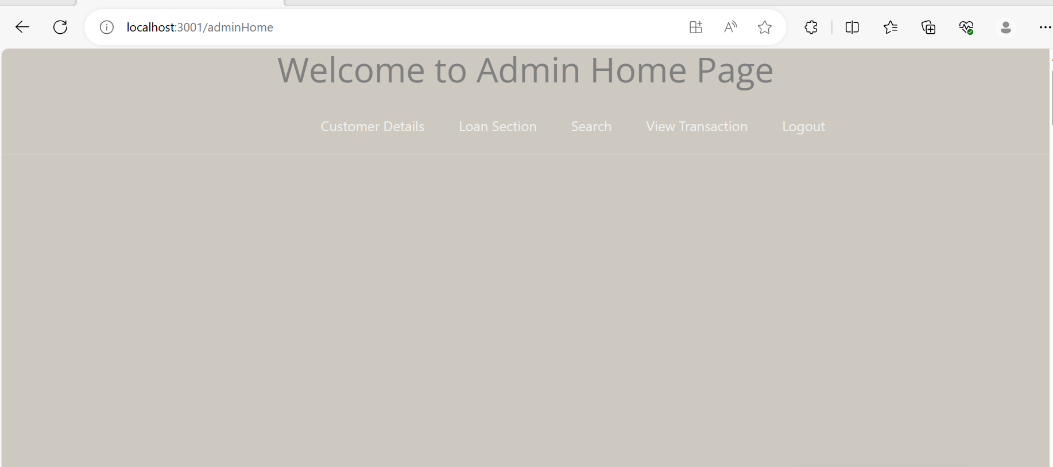

Slide 38
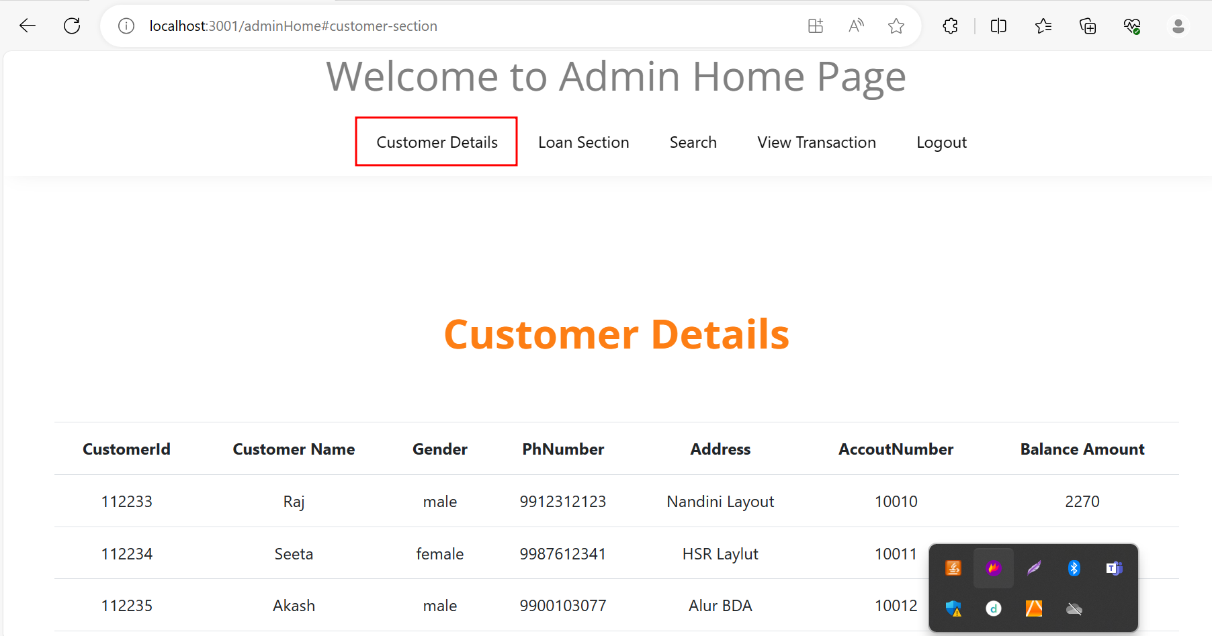

Slide 39
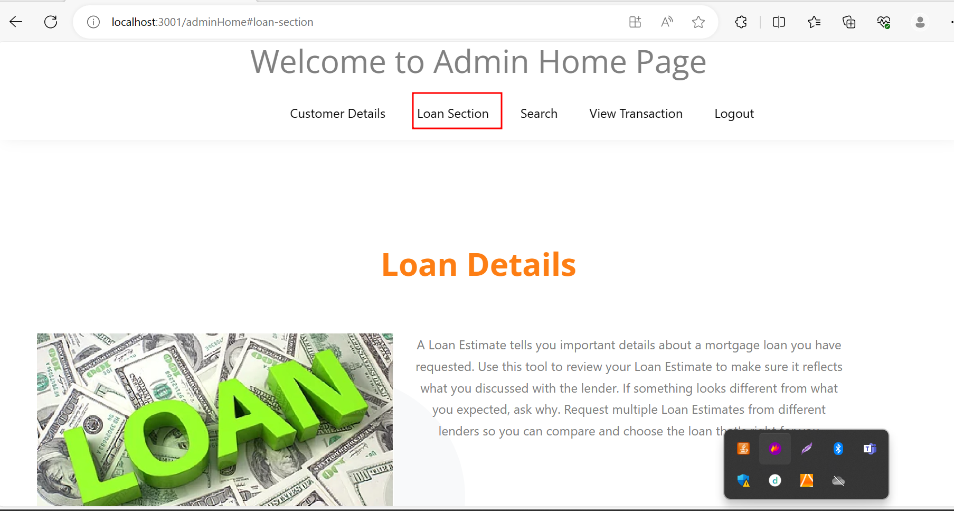

Slide 40
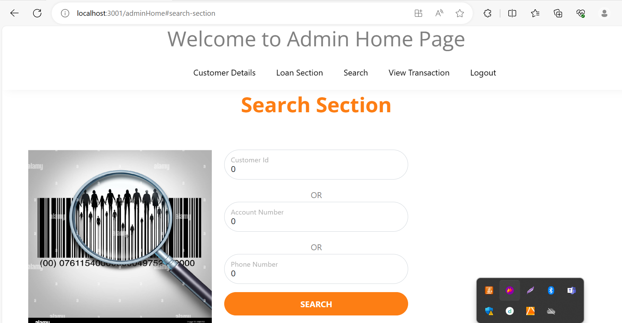

Slide 41
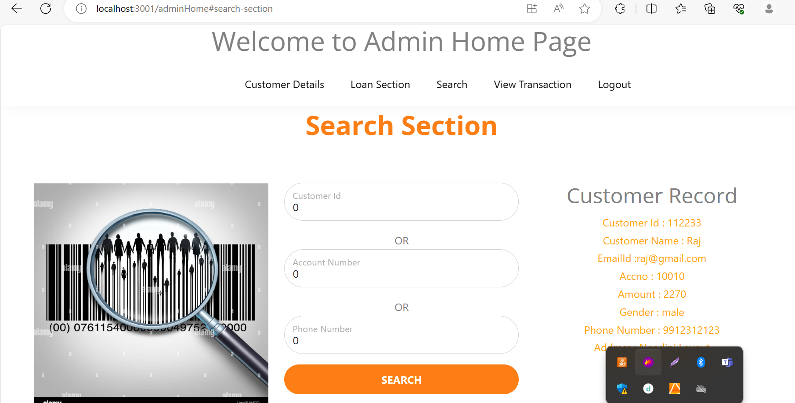

Slide 42
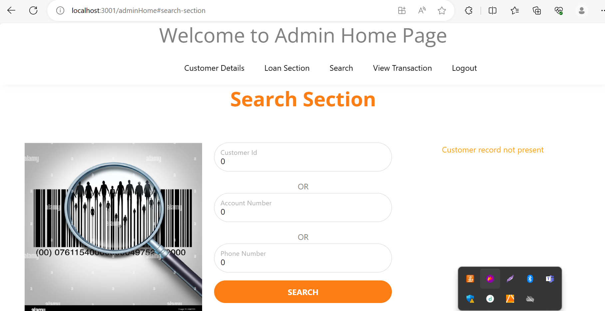

Slide 43
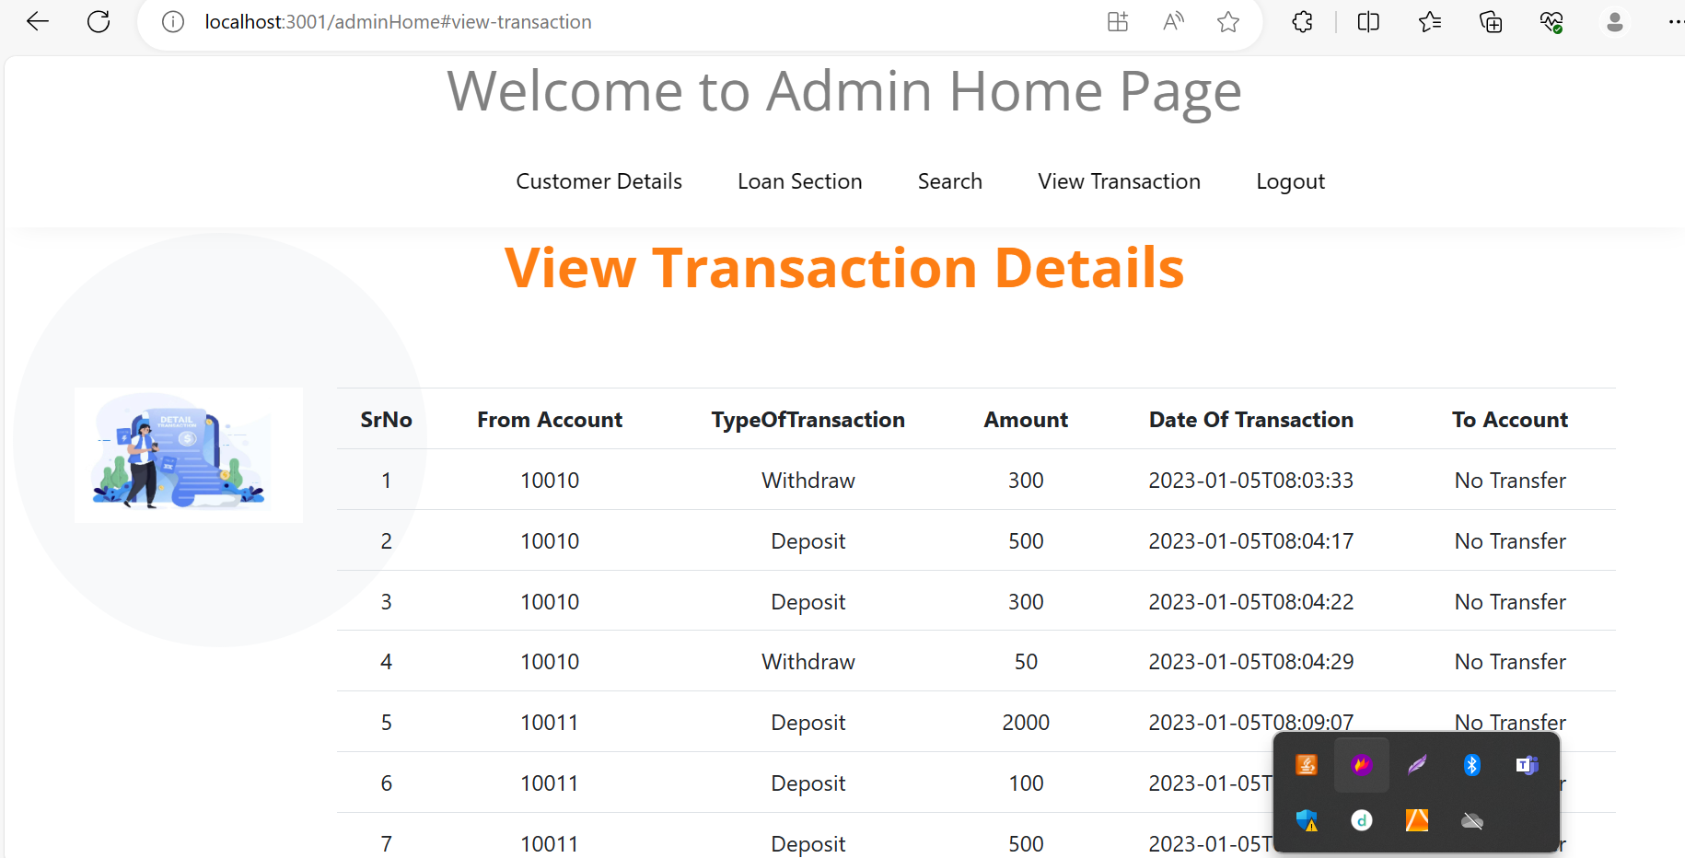

Slide 44
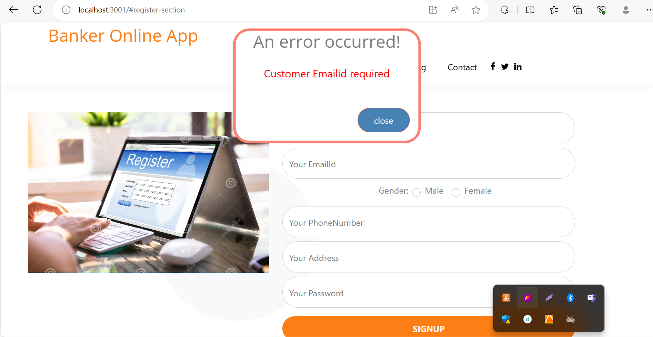
Customer signup

Slide 45
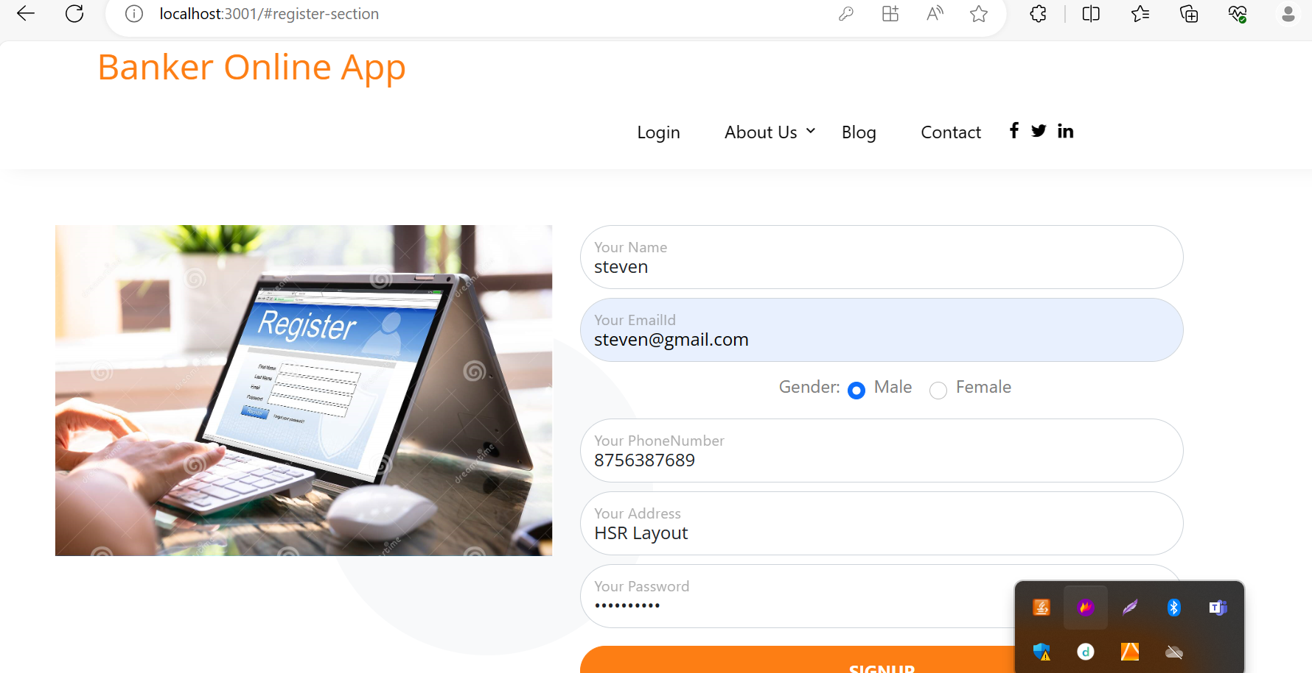
Customer account created.

Slide 46
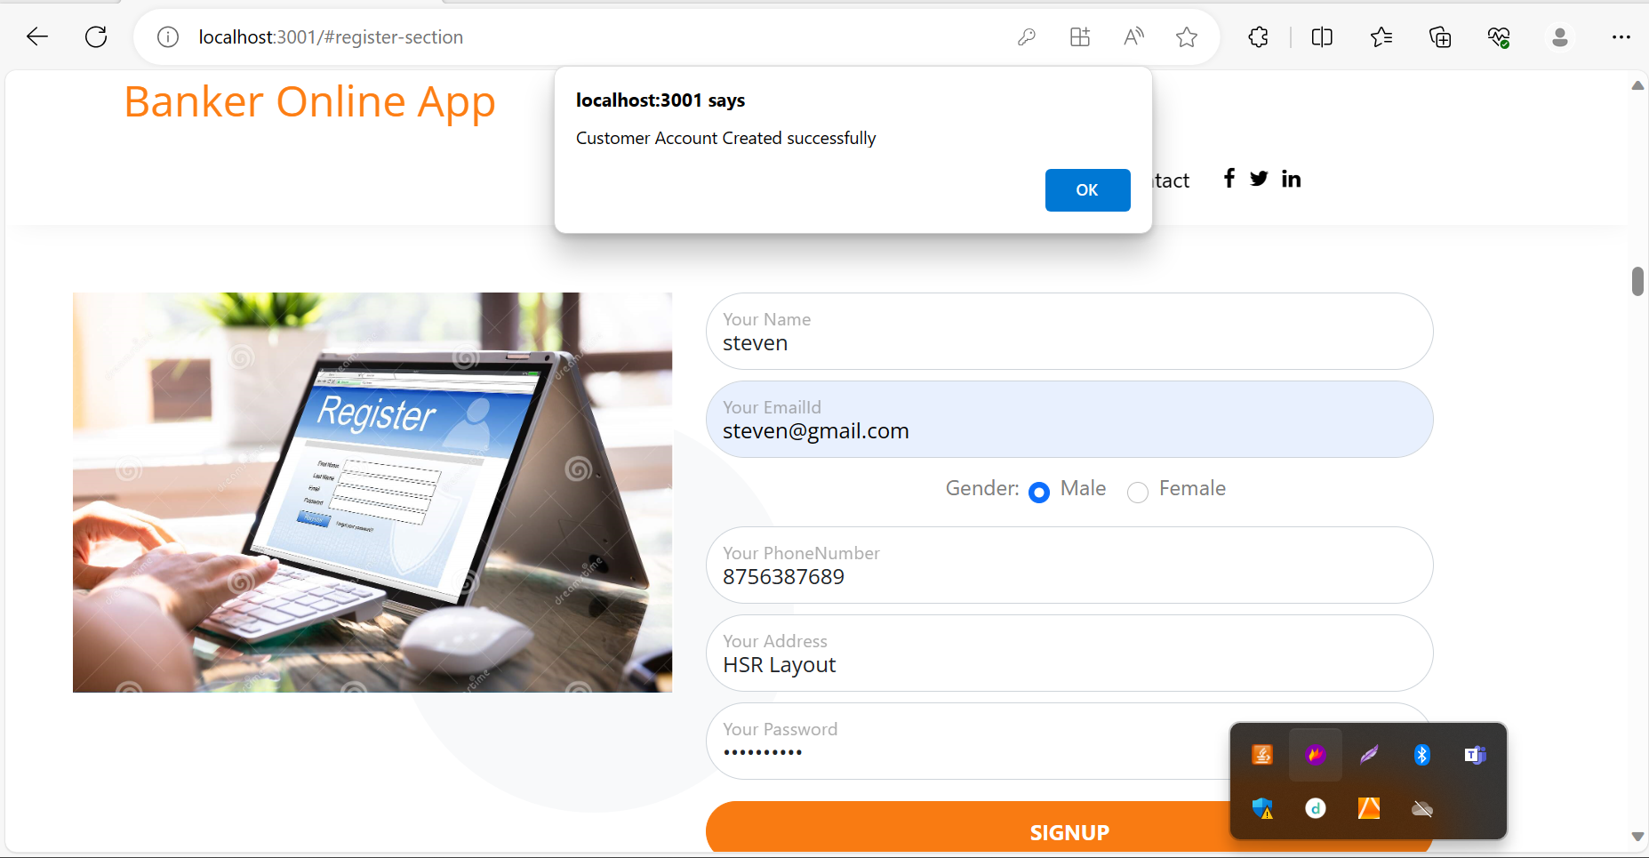

Slide 47
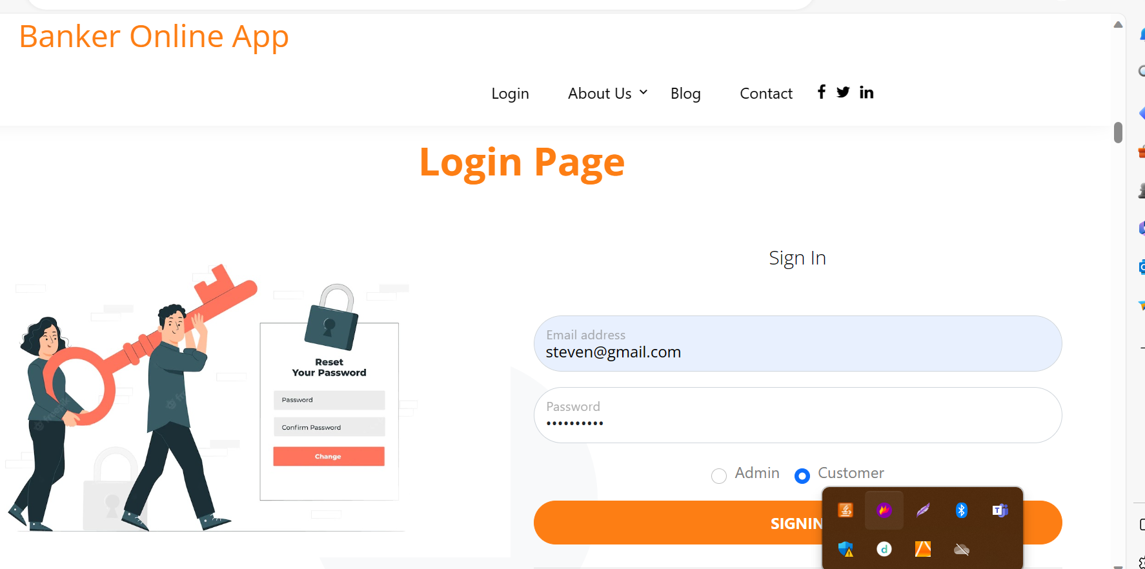
Customer login using steven@gmail.com and password steven@123

Slide 48
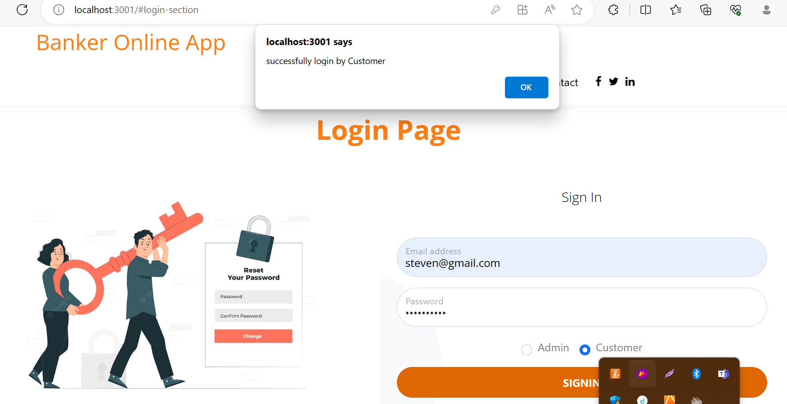

Slide 49


Slide 50


Slide 51


Slide 52


Slide 53


Slide 54


Slide 55


Slide 56


Slide 57


Slide 58


Slide 59


Slide 60


Slide 61

After logout customer

